Slide 1

The EV Futures
Name

Slide 2

Business Problem
EU and California recently rolled out plans to phase internal combustion cars by 2035.
Currently there are four publicly traded fully electric vehicle manufacturing companies.
Goal of this project is to analyze the current stock and forecast futures of the four companies.
Evaluate whether the greater world are onboard with the new future of only electric vehicles

Slide 3
Data Overview
Source:
Stocking trading information was sourced from the yahoo API.
Entire trading history was included in this project.
Background:
TSLA is the only company based in North America and the other three companies are based out of China.
TSLA has been trading for 12 years
NIO has traded for 3 years
Both LI and XPEV have only been trading for a year

Slide 4
Exploratory Data Analysis

Slide 5
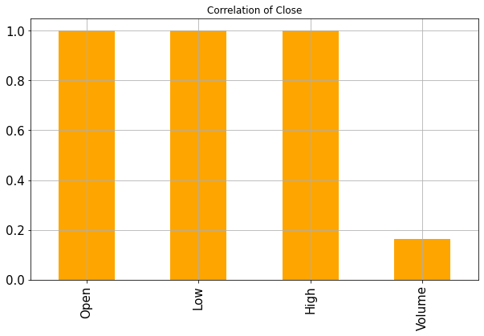
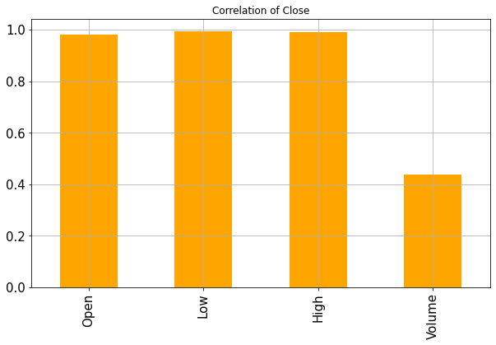
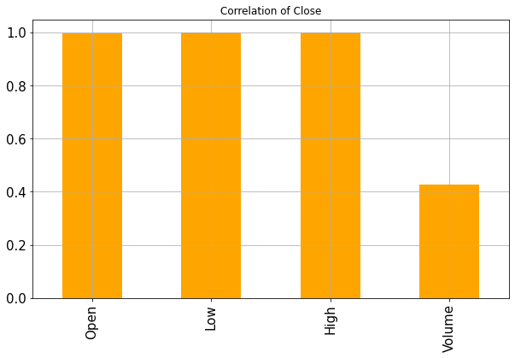

TSLA
Feature correlations with price close
LI
NIO
XPEV

Slide 6
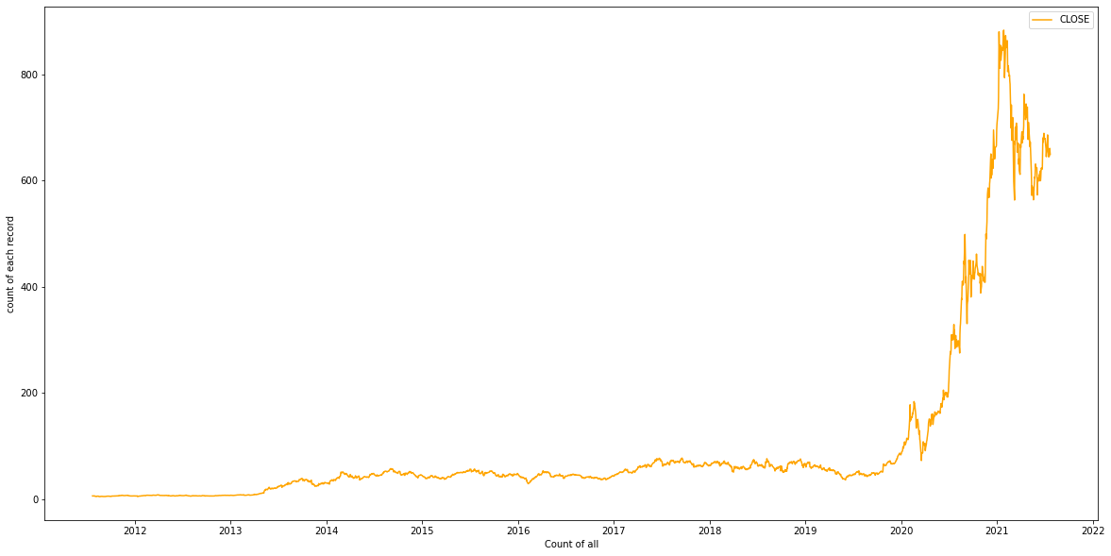
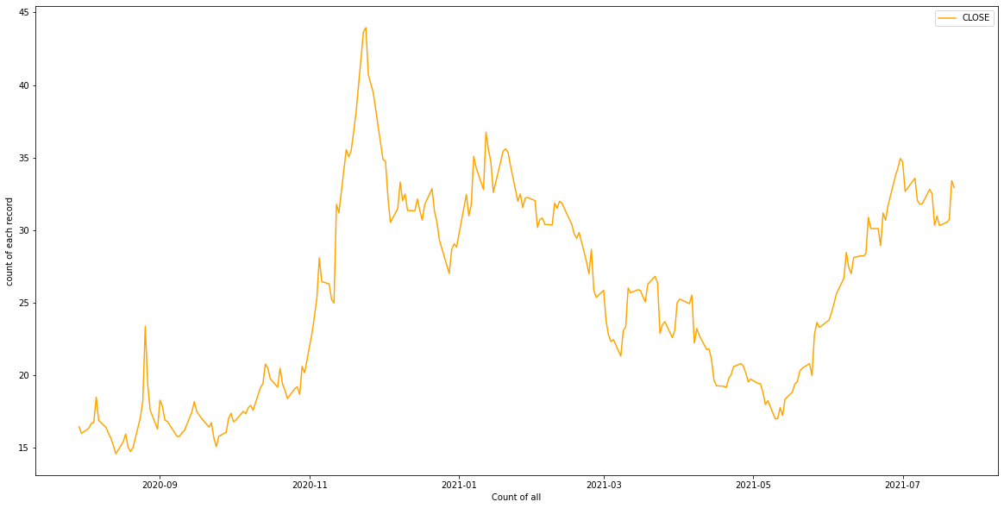
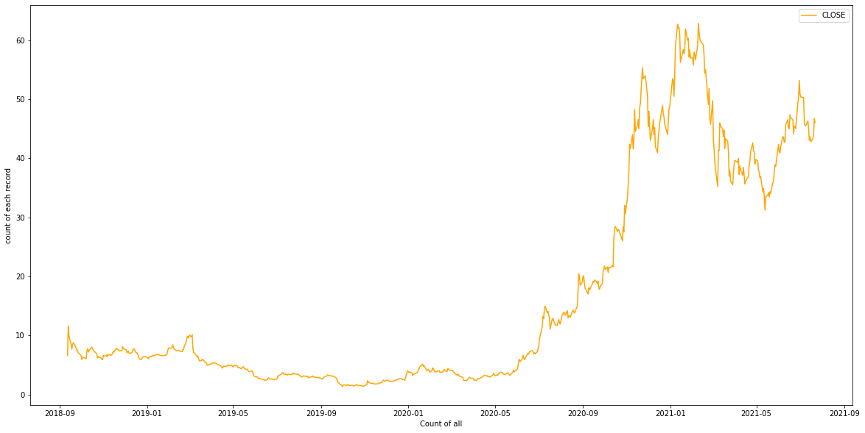
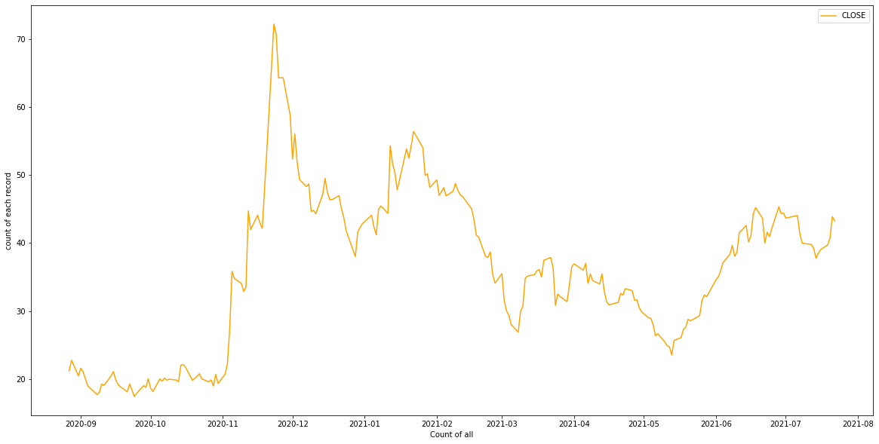
TSLA
Stock Trading Trends
LI
NIO
XPEV

Slide 7

MACHINE LEARNING PROCESS

Slide 8
Process Overveiw
Target and Features
Modelling
Target
Models
Daily Stock Closing prices
Baseline LSMT model
ARIMA and SARIMA models
Features and Transformations
Model Tuning
Open, low, high, volume
Normalized
Data time series split into train and test -70% to 30%

Slide 9
FIRST SIMPLE MODELS WITH LSMT

Slide 10
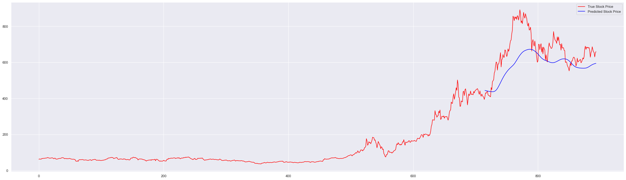
TSLA
Mean Absolute Error - $91.2

Slide 11
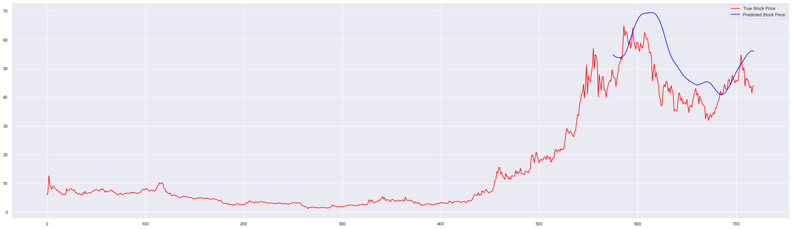
NIO
Mean Absolute Error - $8.65

Slide 12
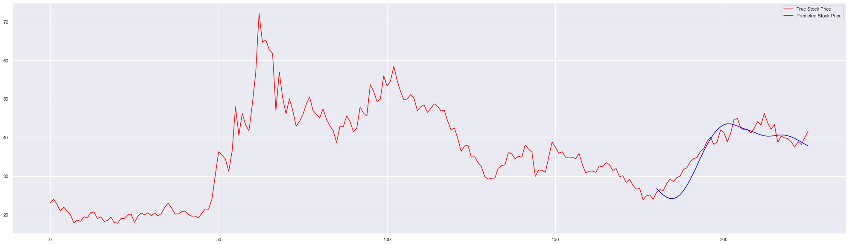
XPEV
Mean Absolute Error - $2.27

Slide 13
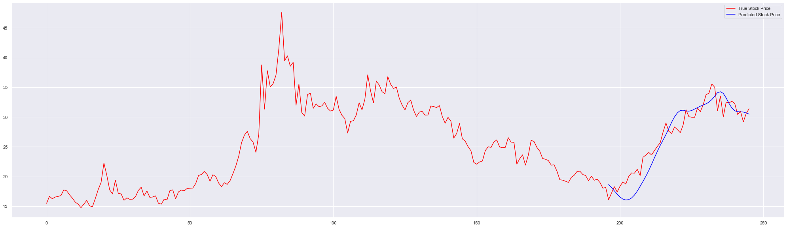
LI
Mean Absolute Error - $1.72

Slide 14

FINAL MODEL

Slide 15

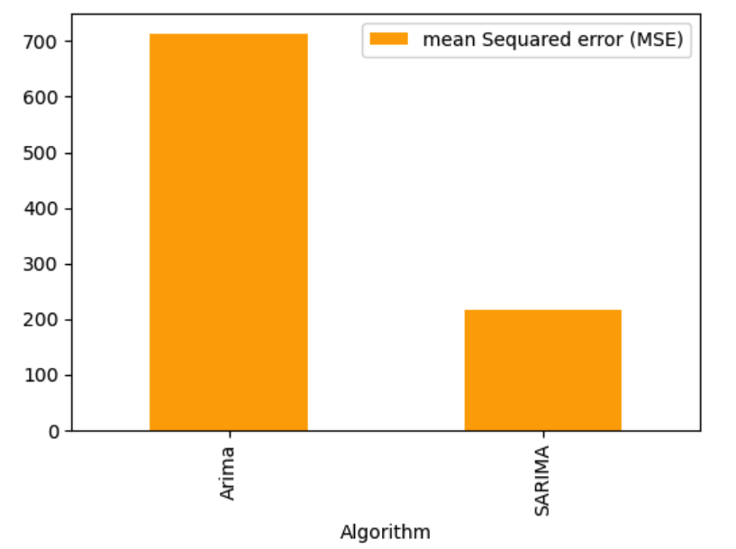
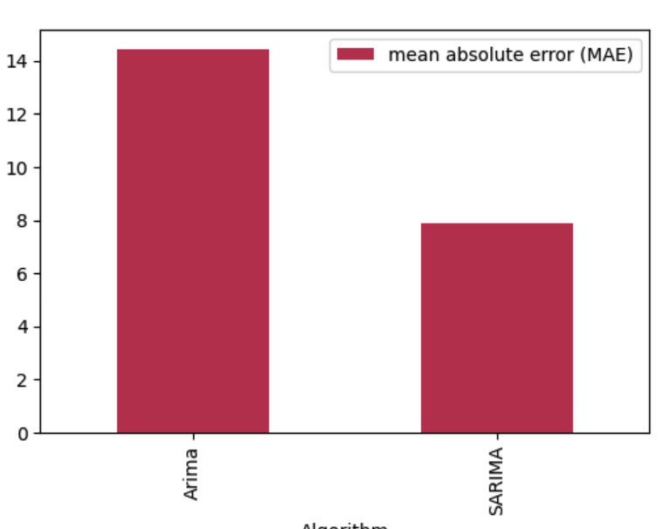
SARIMA – Overall Had the best evaluation metrics
Sample Metrics represent the model on TSLA stock

Slide 16
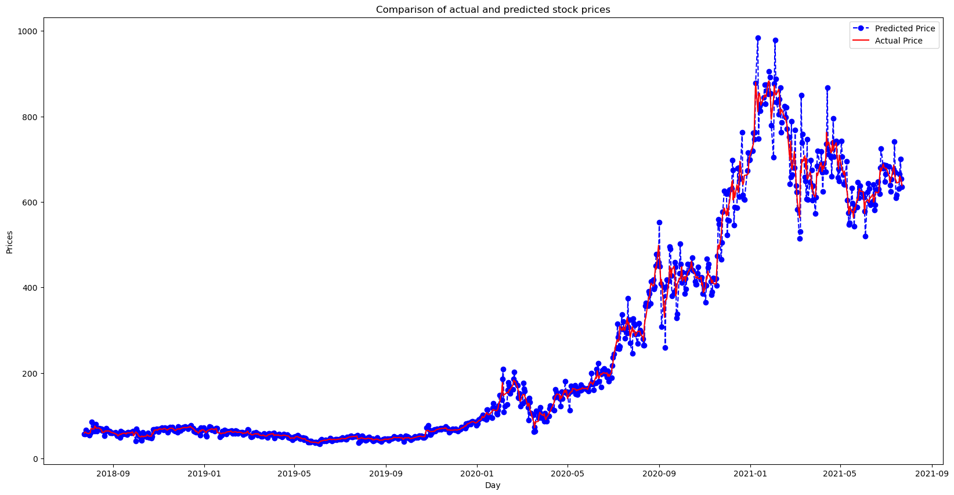
SARIMA TSLA Actual Vs Predicted Stock Prices
MEA – $7.88

Slide 17
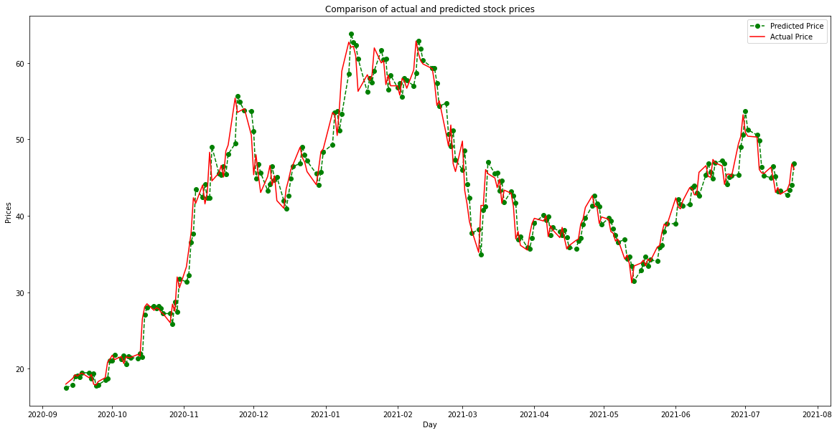
SARIMA NIO Actual Vs Predicted Stock Prices
MEA – $1.60

Slide 18
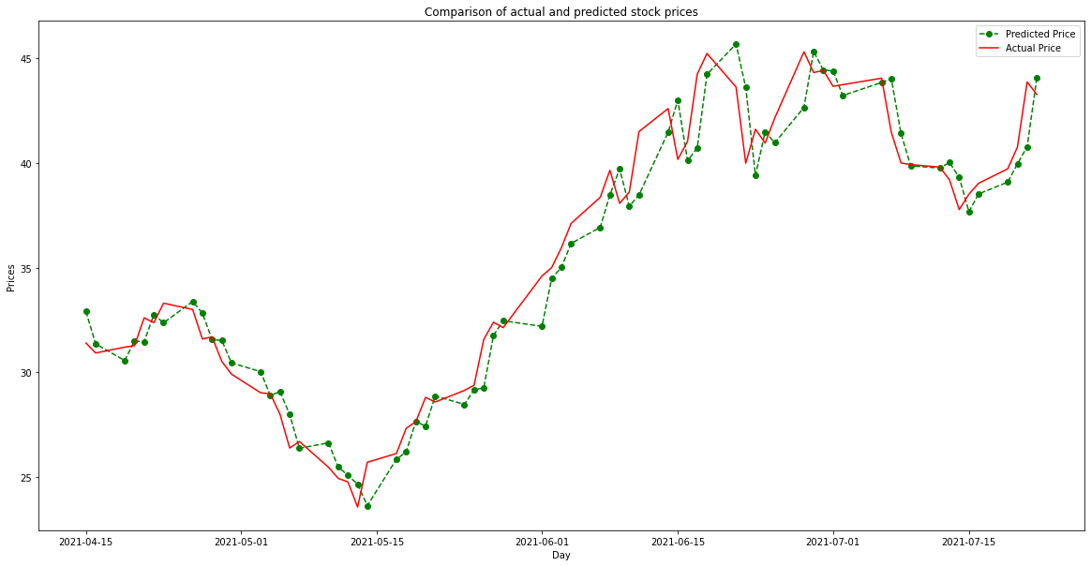
SARIMA XPEV Actual Vs Predicted Stock Prices
MEA – $1.99

Slide 19
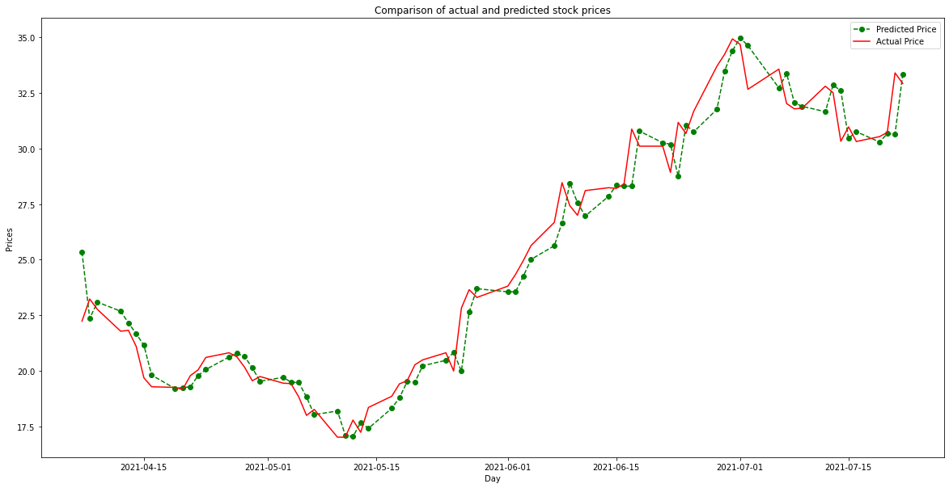
SARIMA LI Actual Vs Predicted Stock Prices
MEA – $0.97

Slide 20

FORECASTS

Slide 21
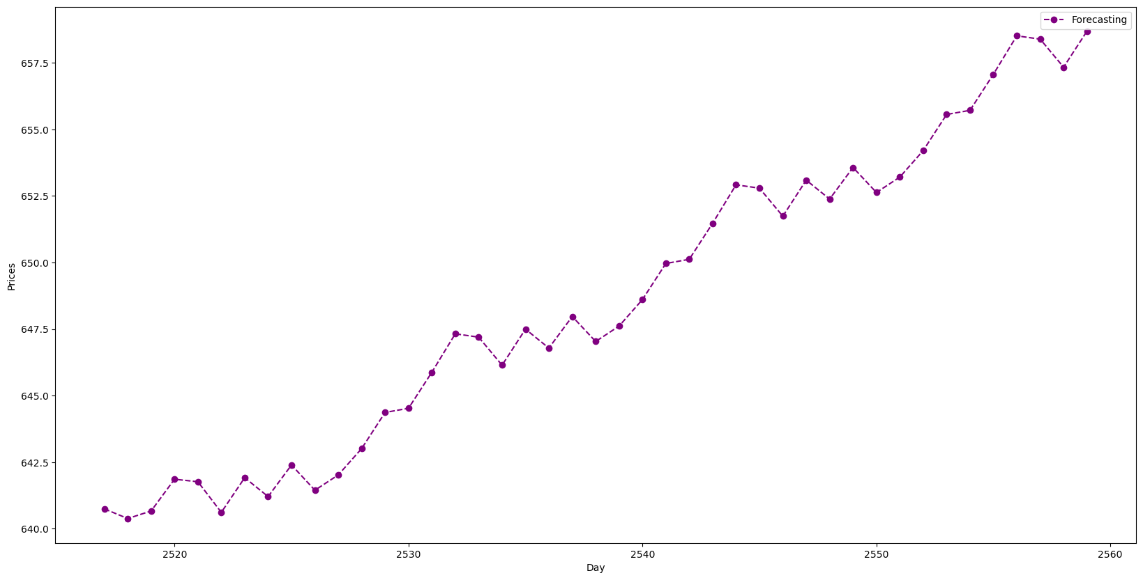
TSLA 42 DAY STOCK FORECAST

Slide 22
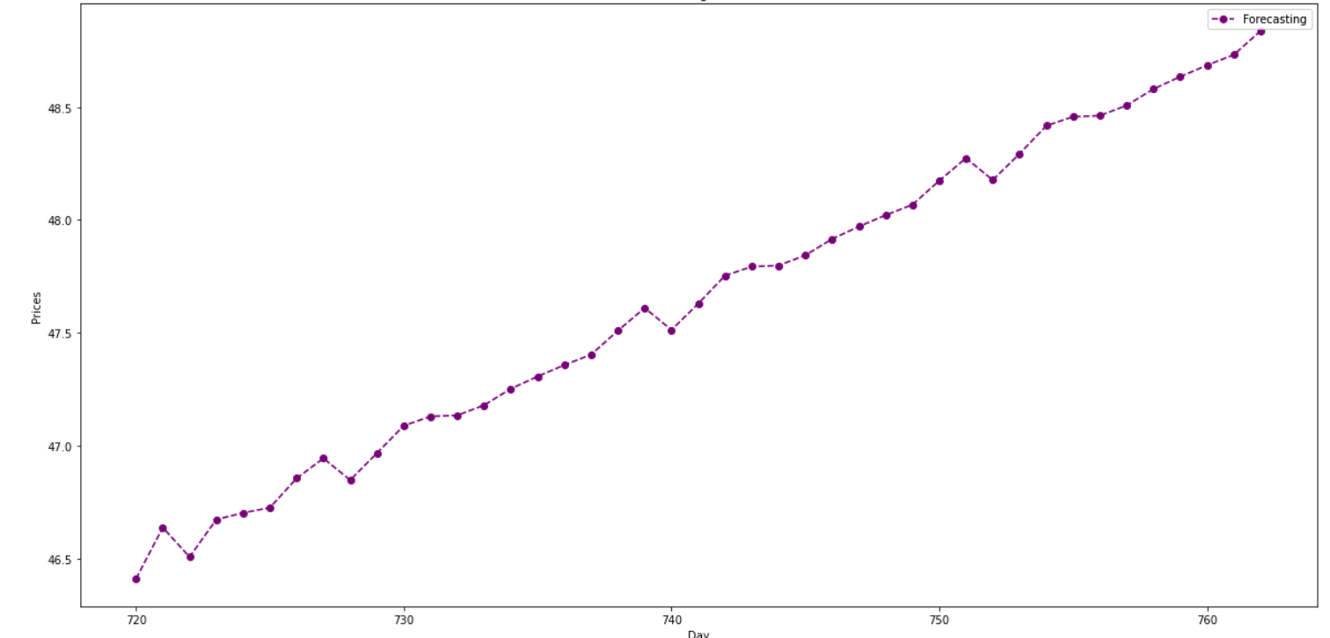
NIO 42 DAY STOCK FORECAST

Slide 23
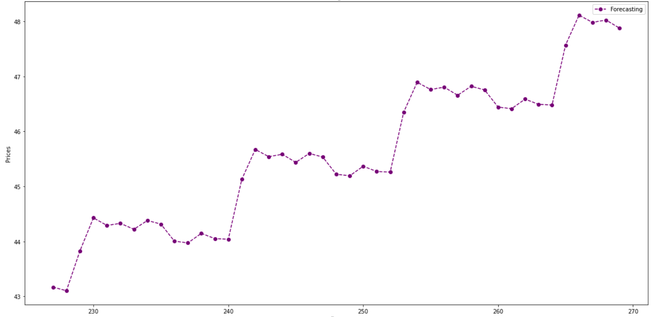
XPEV 42 DAY STOCK FORECAST

Slide 24
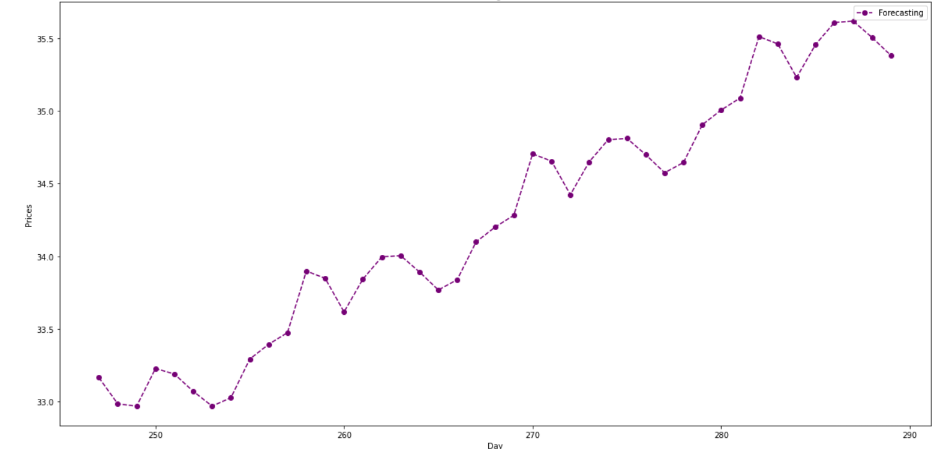
LI 42 DAY STOCK FORECAST

Slide 25
CONCLUSIONS

Slide 26

Key Results & Deductions
All EV Stocks are forecasted to be trending higher
Previous Short-term trend was currently up for all the EV stocks as well
Indication of short-term interest in all these stocks
General Stock market trend not included
General Automotive market trend not included

Slide 27
Next Steps
General Market & Industry Inclusion
Stock trading Volume analysis
Publishing all inclusive results

Slide 28

Thank You
Name
Email Address
Contact Number

